Slide 1

The Application of deep learning techniques towards particle identification and high energy physics event simulations
CG Viljoen – MSc Data Science
16 August 2019

Slide 2
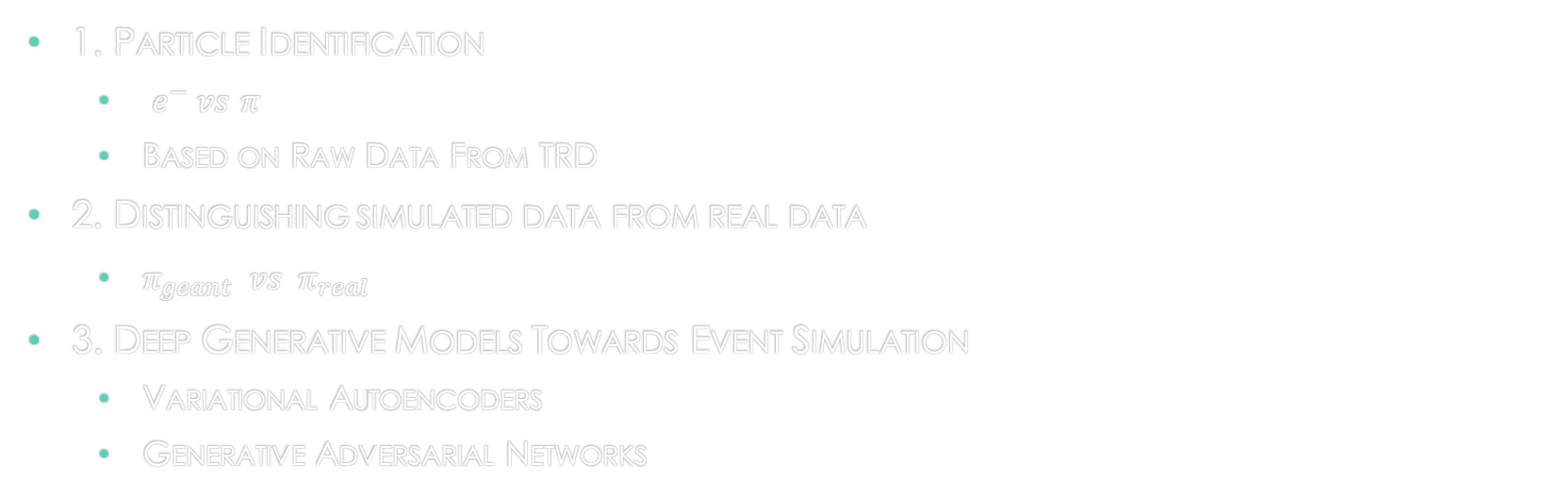
Aims
1. Particle Identification
$e^{−} vs$ $π$
Based on Raw Data From TRD
2. Distinguishing simulated data from real data
$π_{geant} vs π_{real}$
3. Deep Generative Models Towards Event Simulation
Variational Autoencoders
Generative Adversarial Networks

Slide 3
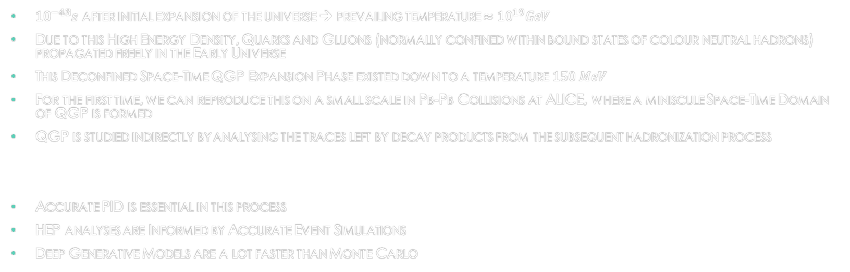
Motivation: Quark Gluon Plasma
${10}^{−43}s$ after initial expansion of the universe → prevailing temperature $≈{10}^{19}GeV$
Due to this High Energy Density, Quarks and Gluons (normally confined within bound states of colour neutral hadrons) propagated freely in the Early Universe
This Deconfined Space-Time QGP Expansion Phase existed down to a temperature $150 MeV$
For the first time, we can reproduce this on a small scale in Pb-Pb Collisions at ALICE, where a miniscule Space-Time Domain of QGP is formed
QGP is studied indirectly by analysing the traces left by decay products from the subsequent hadronization process
Accurate PID is essential in this process
HEP analyses are Informed by Accurate Event Simulations
Deep Generative Models are a lot faster than Monte Carlo

Slide 4
Presentation Outline
The ALICE Detector System & the TRD
Deep Learning
Latent Variable/
Deep Generative Models

Slide 5
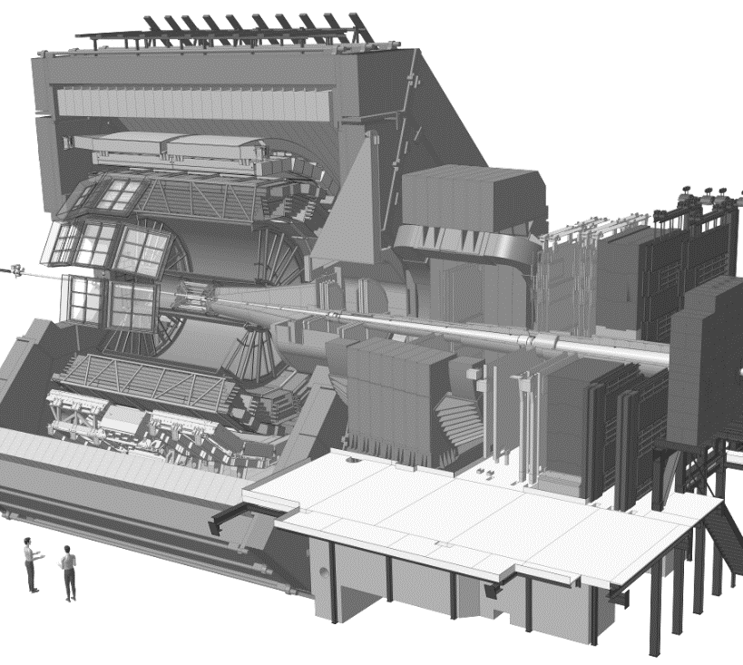

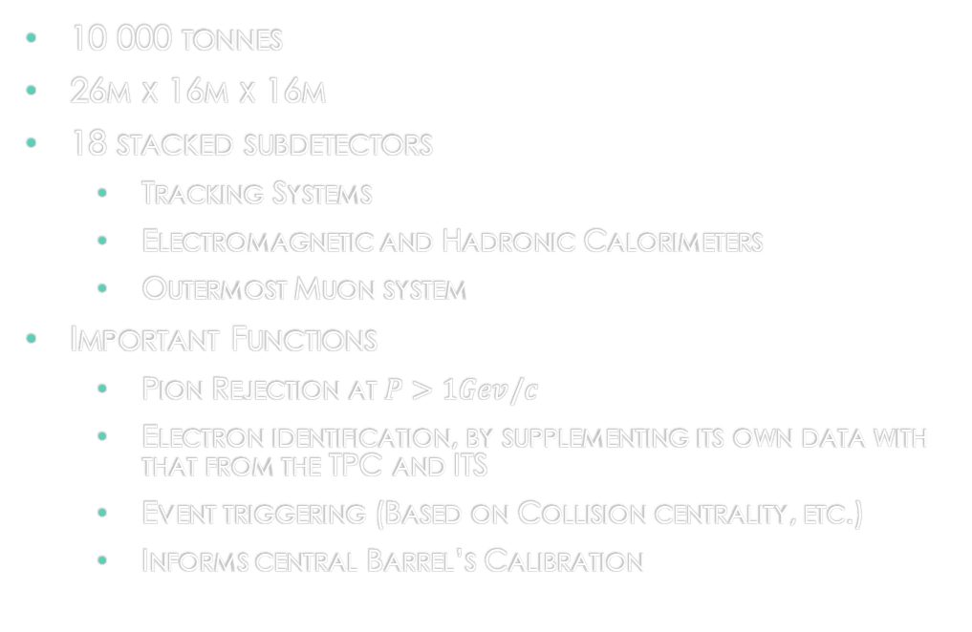
The ALICE Detector system
10 000 tonnes
26m x 16m x 16m
18 stacked subdetectors
Tracking Systems
Electromagnetic and Hadronic Calorimeters
Outermost Muon system
Important Functions
Pion Rejection at $P>1Gev/c$
Electron identification, by supplementing its own data with that from the TPC and ITS
Event triggering (Based on Collision centrality, etc.)
Informs central Barrel’s Calibration

Slide 6
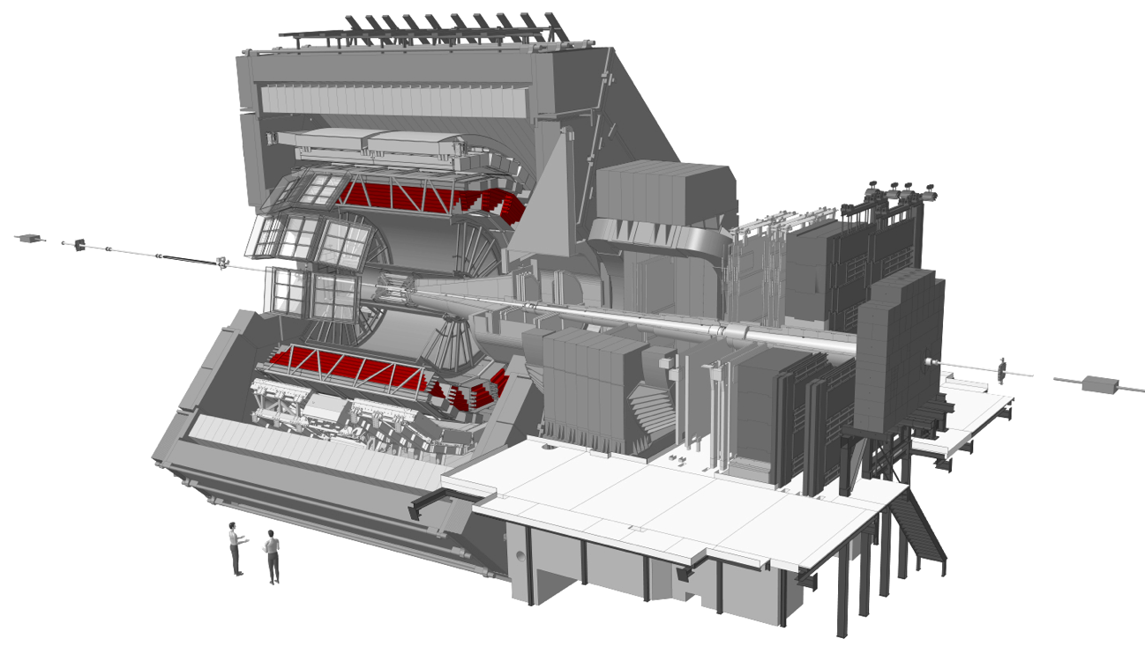
Transition radiation detector

Slide 7
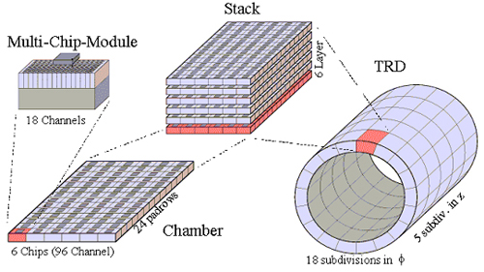

Slide 8
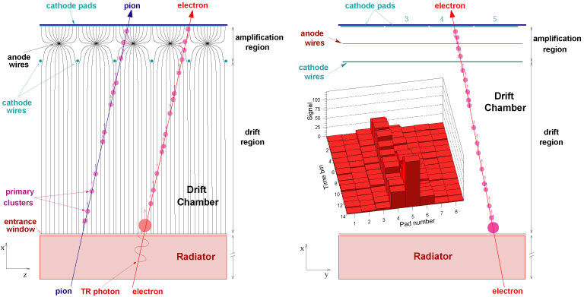

Slide 9
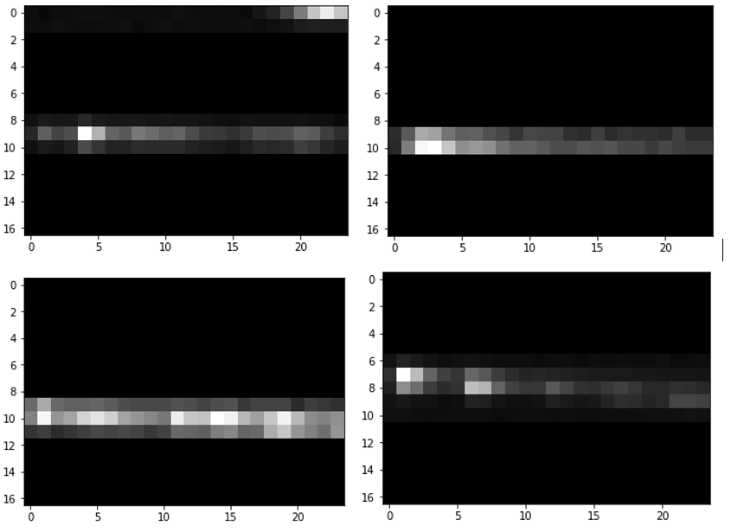

Slide 10
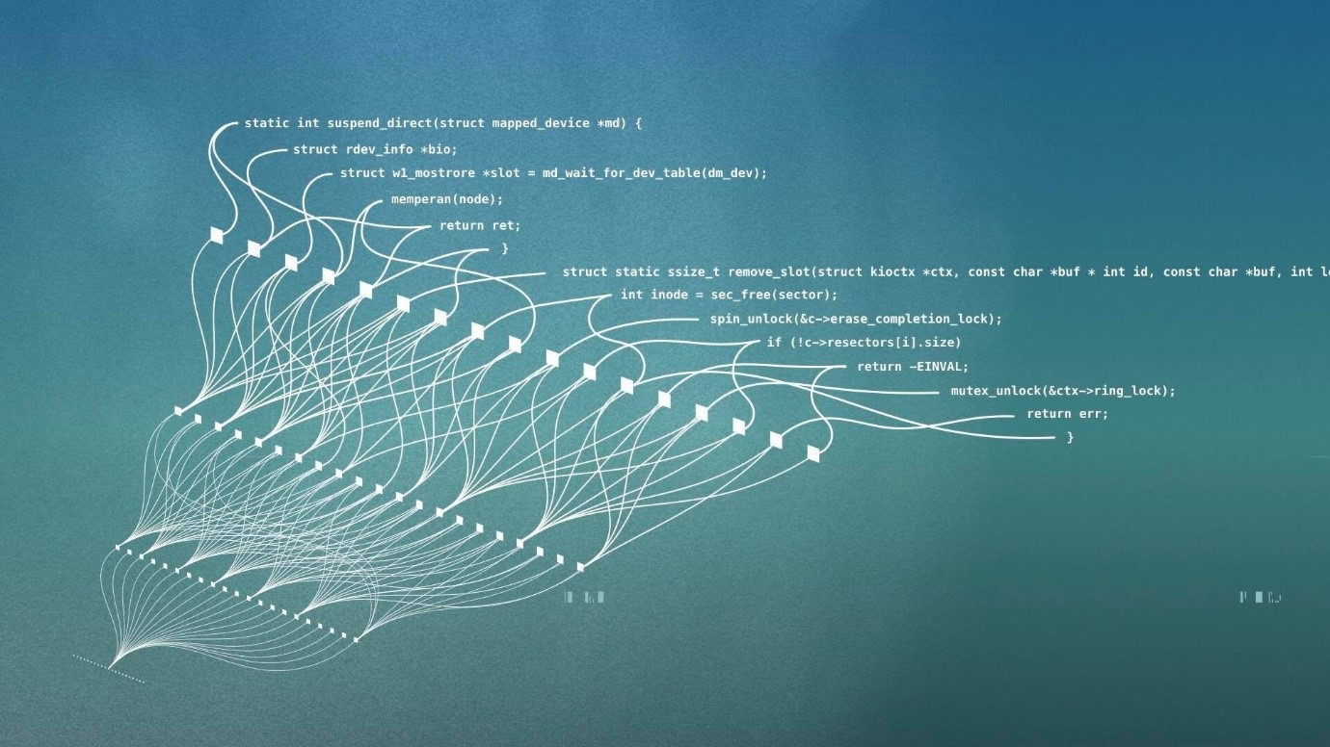
Deep learning

Slide 11


Slide 12
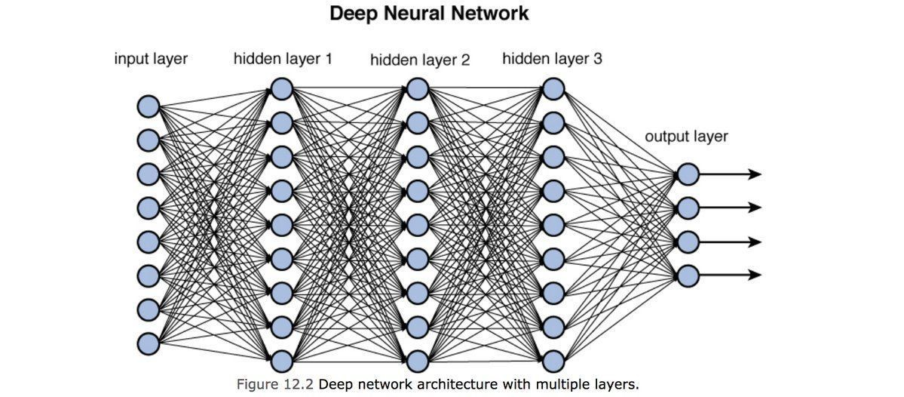


Deep feedforward networks
Nested approximating mapping functions
Maps $x_{i} ; i=\{1,2,…,n\}$ → $y$
$f\left(x_{i,..,n}\right)= f_{a}^{m}(f_{a}^{…}(f_{a}^{2}(f_{a}^{1}(x_{i,…,n}))))$
Each layer takes the form: $w^{T}x+b$
Non-linear activation functions $φ(f_{a}(x))$ captures non-linearities in the multidimensional feature space
Goal → to arrive at a theoretically optimal mapping function $f^{∗}(x)≈y$

Slide 13
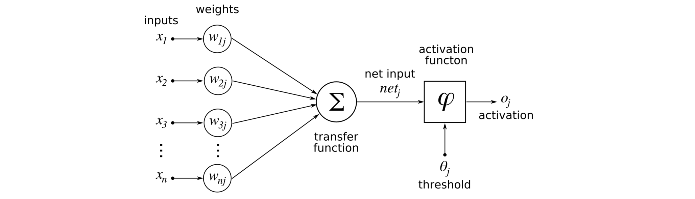

Slide 14
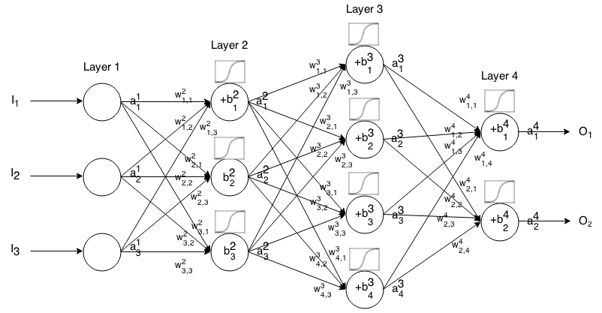
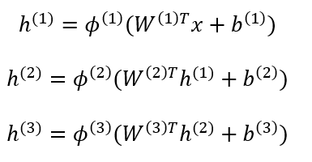

Slide 15
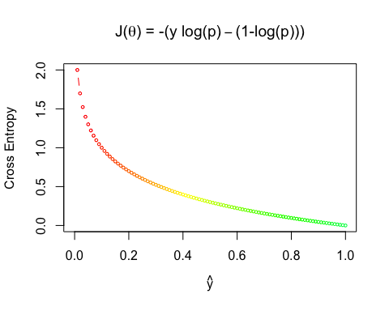

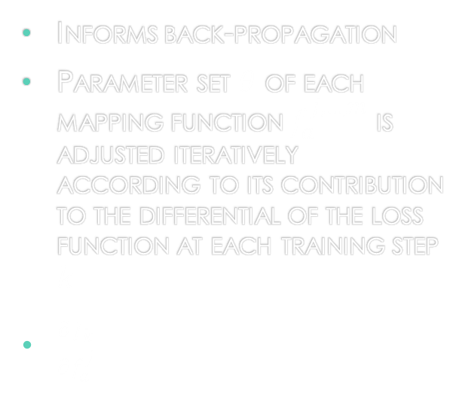
Loss Function
Informs back-propagation
Parameter set $θ$ of each mapping function $f_{a}^{j,…,m}$ is adjusted iteratively according to its contribution to the differential of the loss function at each training step $k$
$\frac{∂J_{k}}{∂f_{a}^{j}}$

Slide 16
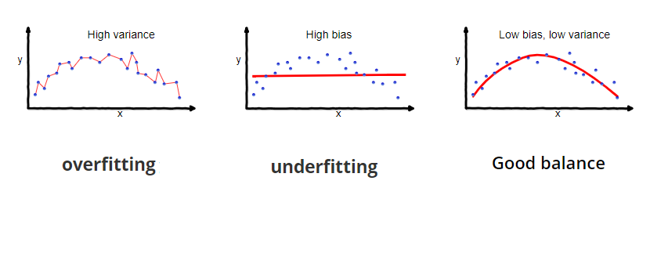
Not too perfect
Bias-variance trade-off
regularization
L2-Norm Penalty
Drop-out
Limiting capacity of network
Gaussian Noise Layers
Early Stopping

Slide 17
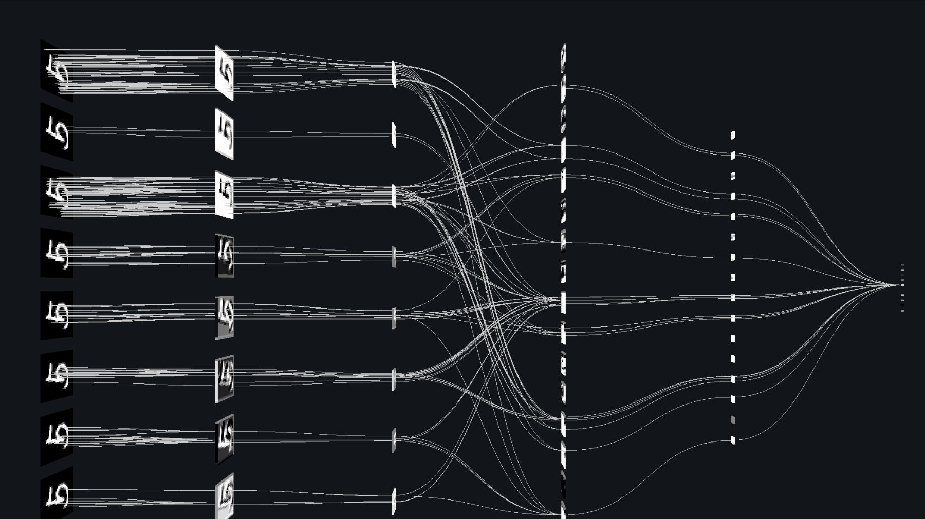
Convolutional Neural networks

Slide 18
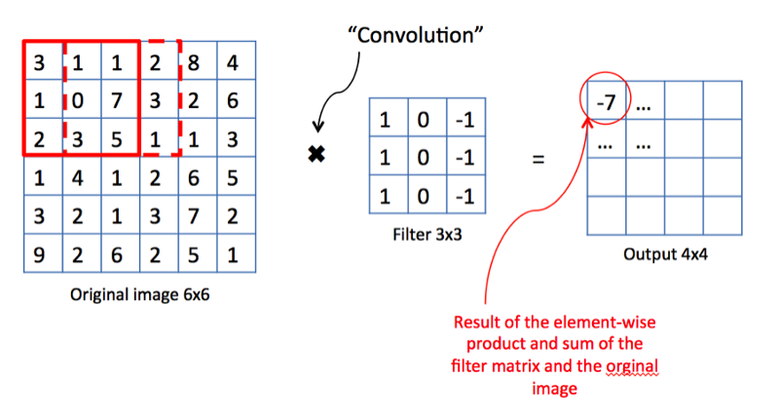
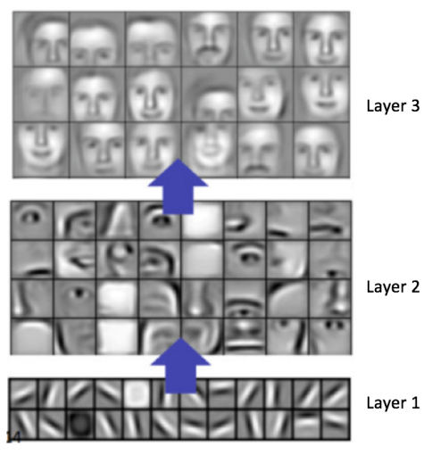
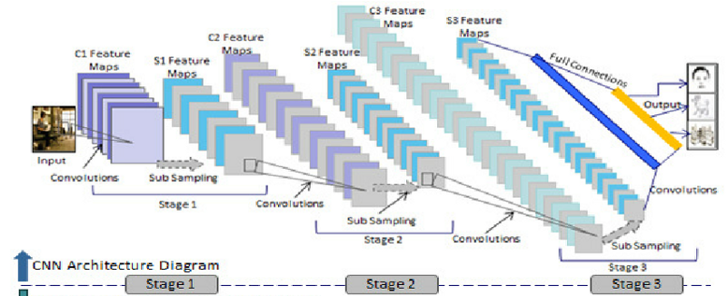
Convolutional Filters

Slide 20
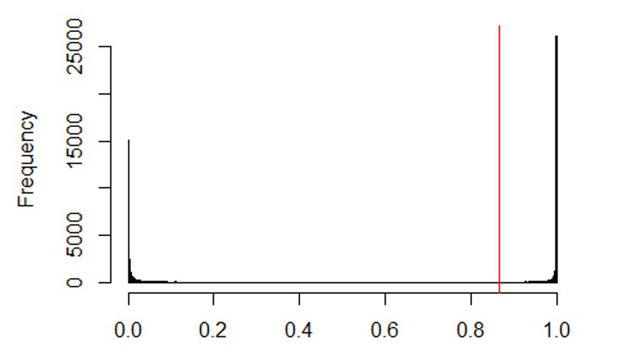
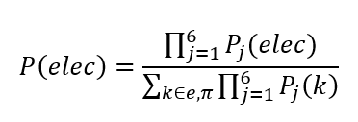
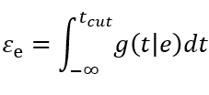

Particle identification results
Pion efficiency $ε_{π}=2.2\%$ at electron efficiency $ε_{e^{−}}=90\%$

Slide 21
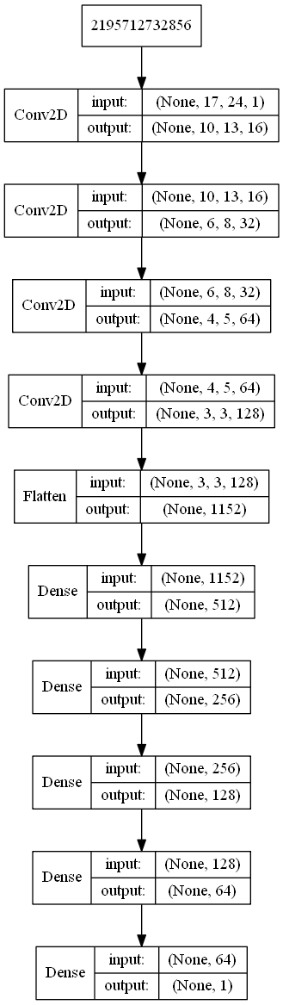
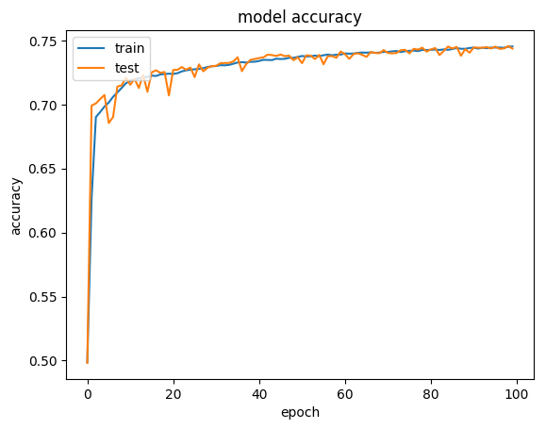
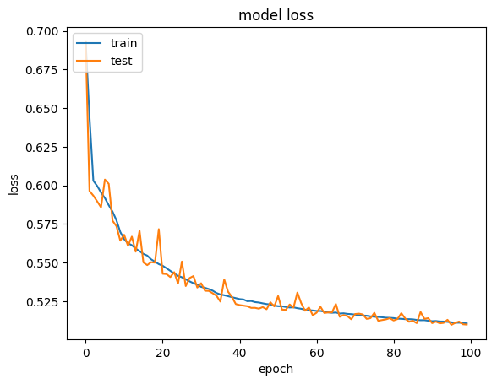
Architecture and training curves

Slide 22
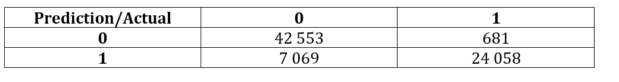
Distinguishing geant from real data results
Balanced Accuracy = 91.05 %

Slide 23
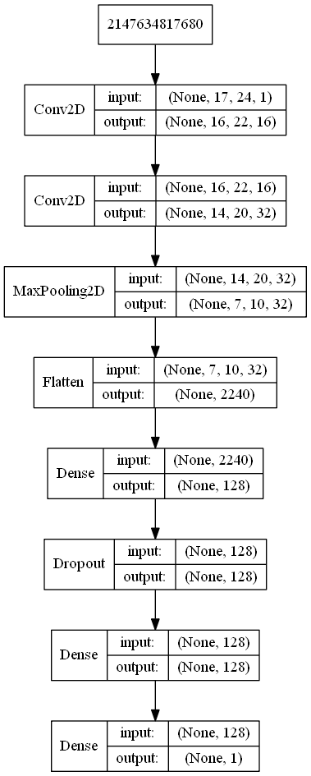
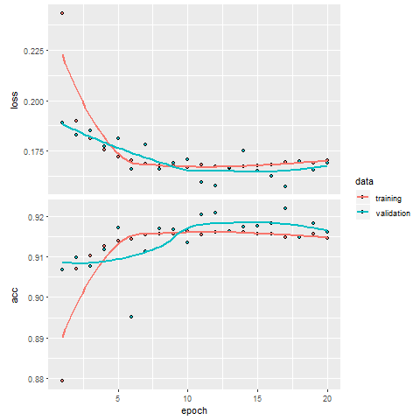
Architecture and training curves

Slide 24
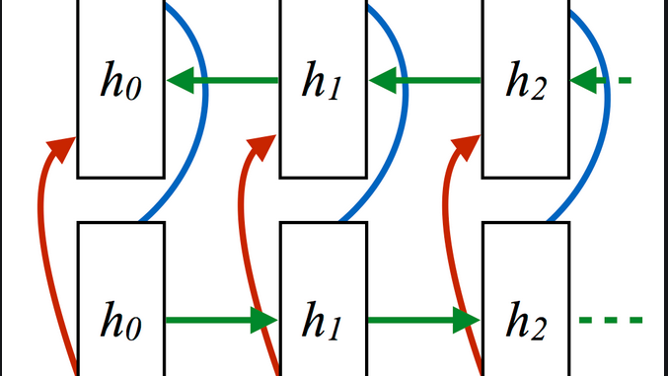
Recurrent neural networks

Slide 25
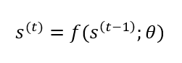
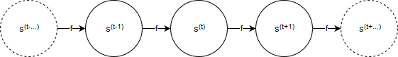
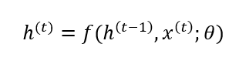
Recurrent neural networks

Slide 26
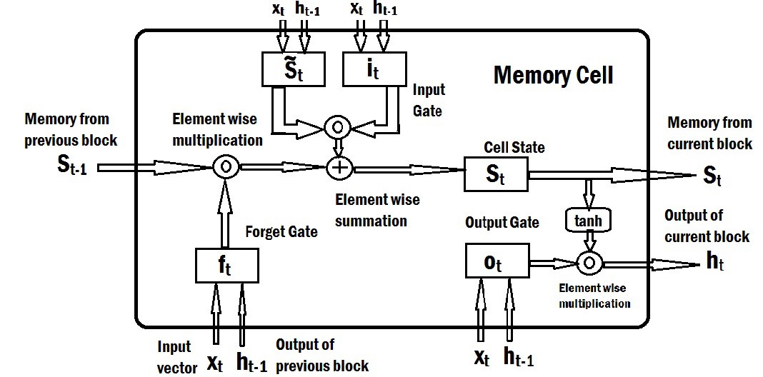
LSTM cell

Slide 27
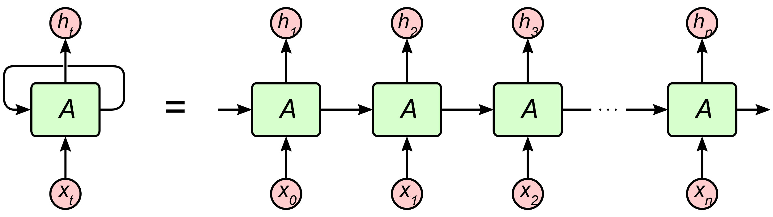
Chain of LSTM CELLS

Slide 28
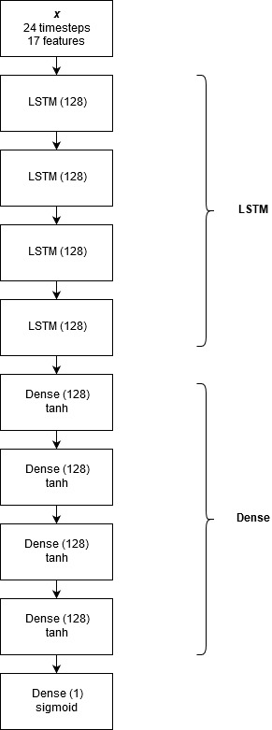
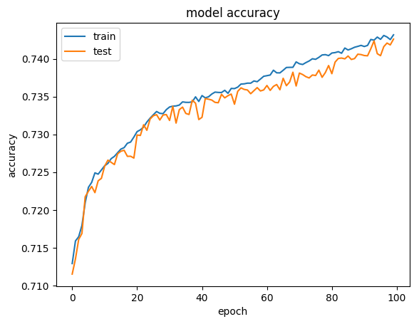

Particle Identification results: LSTM
$ε_{π}=8.5\%$ at $ε_{e^{−}}=90\%$

Slide 29
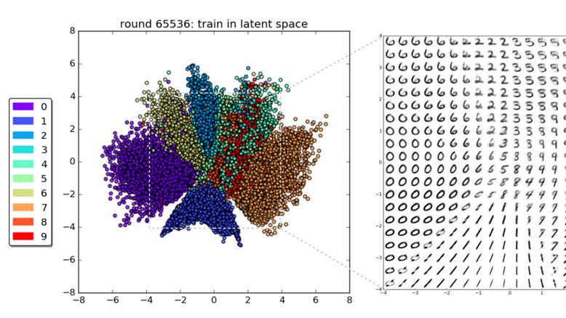
Latent variable models
deep generative modeling

Slide 30
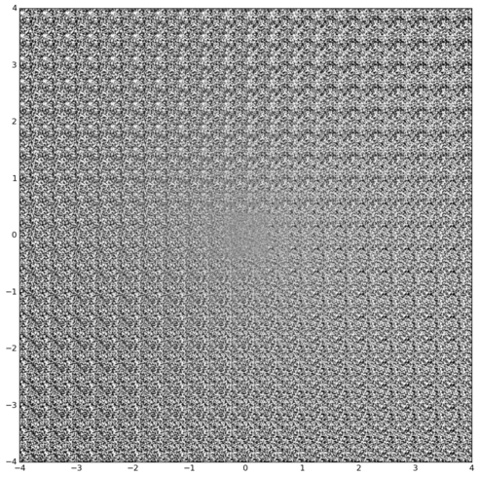
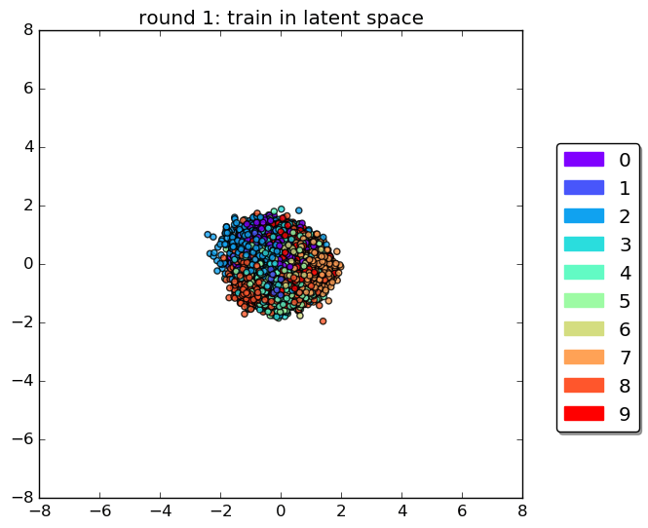

Slide 31
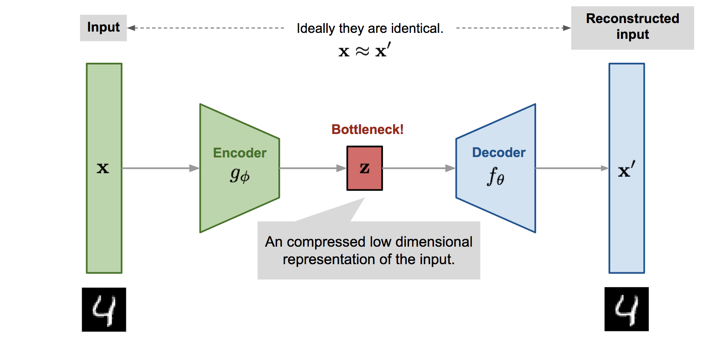
Variational Autoencoders

Slide 32
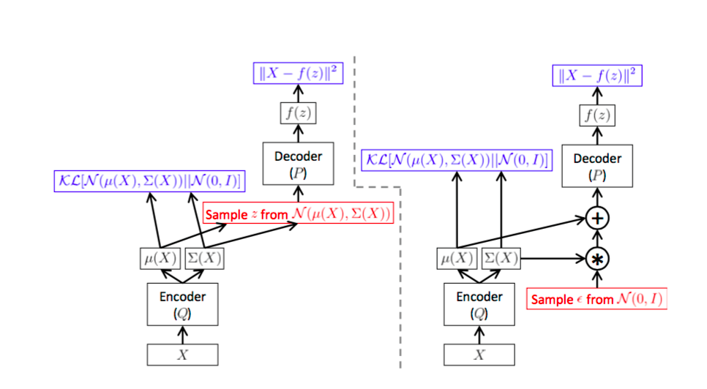

Slide 33
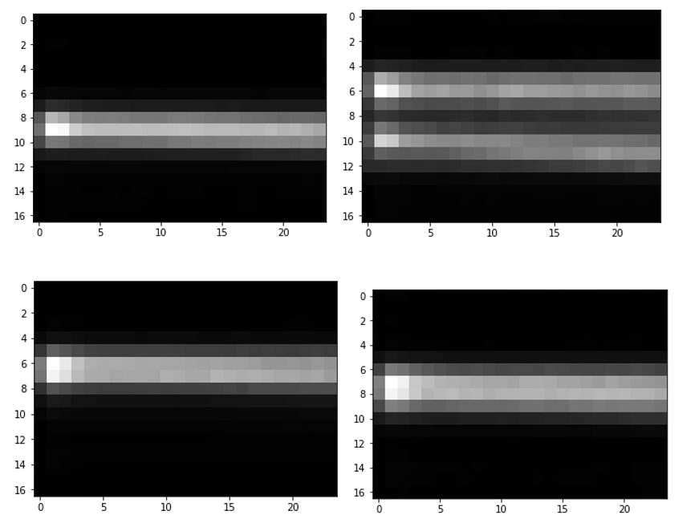
VAE results
Variational Autoencoder
Real Data

Slide 34
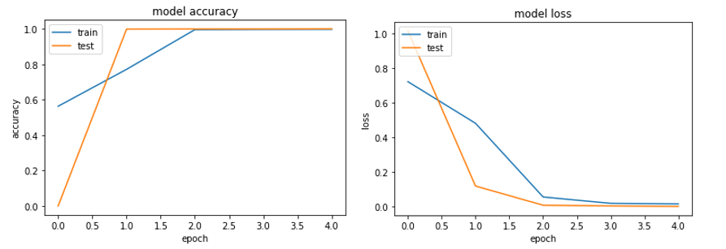
Distinguishing variational autoencoder data from real data

Slide 35
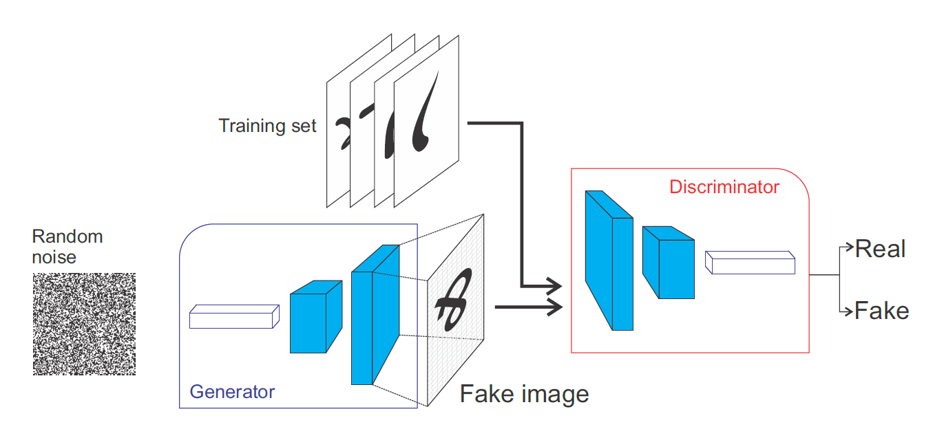
Generative adversarial networks

Slide 36
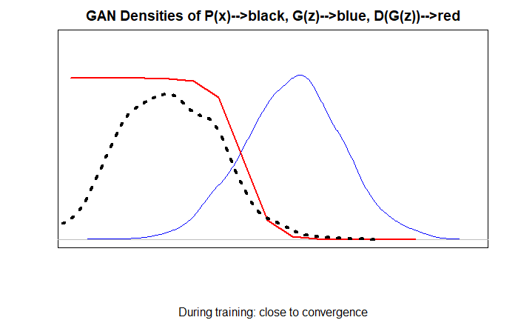
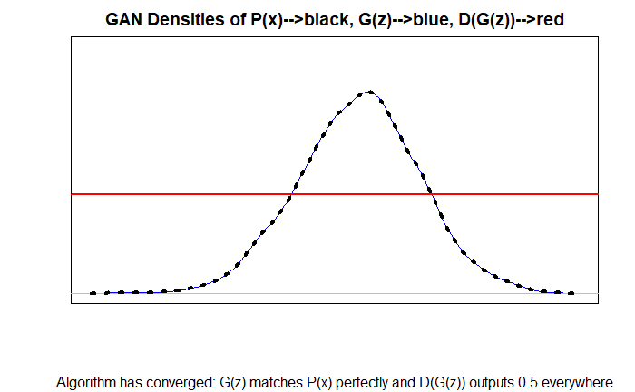
GAN densities during training
Close to convergence
Algorithm has converged

Slide 37
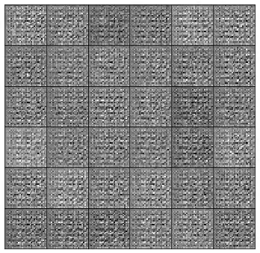
GAN training on mnist

Slide 38
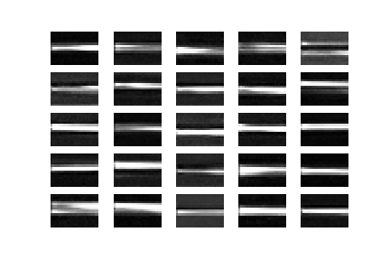
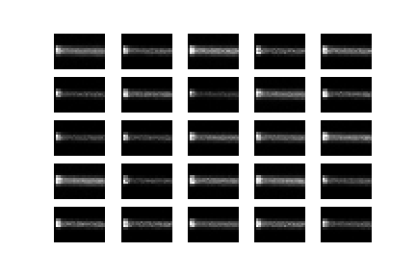
GAN Results
Adversarial autoencoder 1
Adversarial autoencoder 2

Slide 39


GAN results
Bidirectional GAN
Deep convolutional GAN

Slide 40


GAN Results
Vanilla GAN
Least Squares GAN

Slide 41

Any questions?

